Slide 1
Images for Lecture
EECS290 O
Feb 25 2019

Slide 2
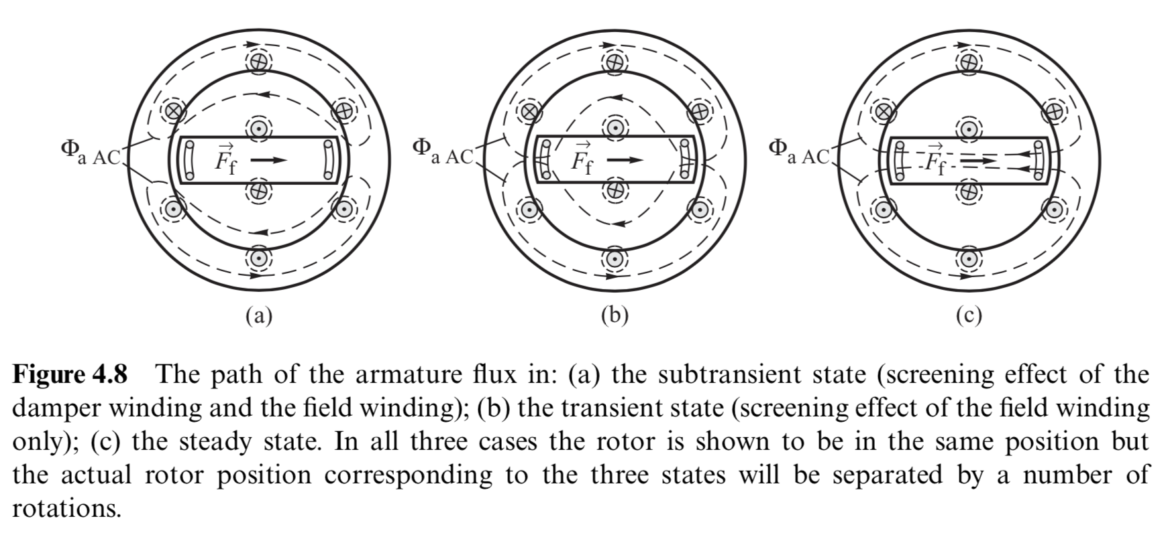

Slide 3
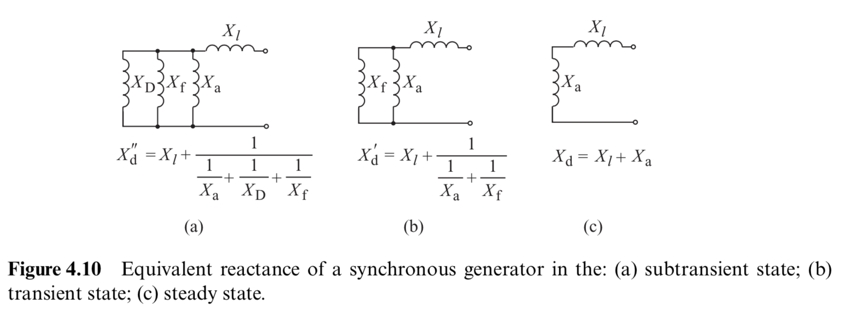
Notes:
l: leakage
D: damper bypass
f: field winding bypass
a: armature (mostly the air gap)

Slide 4
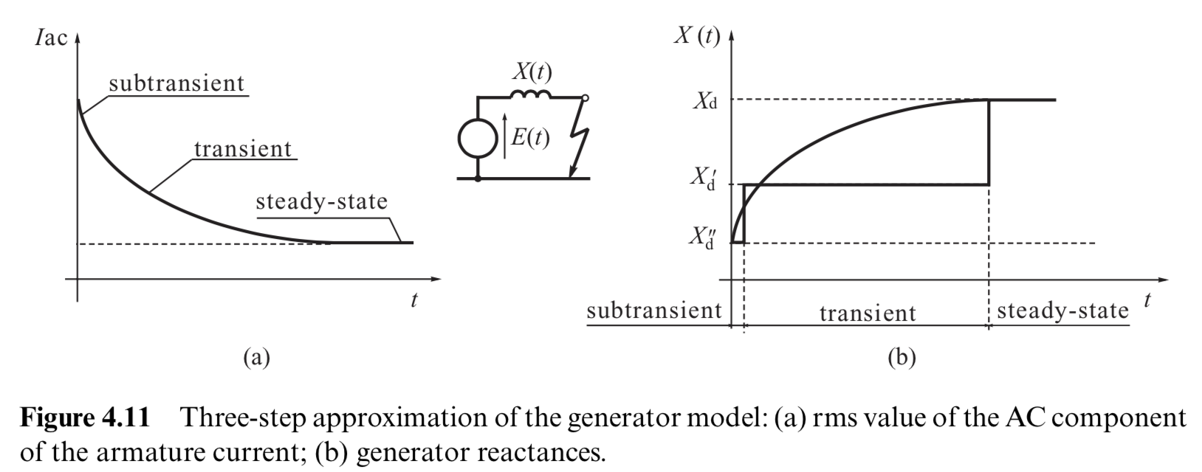

Slide 5
